Slide 1
University Board of Elections
Candidate Information Session
Spring 2020
So YOU Want to Run For Office?
Notes:
Agenda
UBE Overview- fair and equal elections
Online Registration
Candidate Questionnaire/ Nomination Form
Candidate Petitions
Expenditure Reports
Elections Rules & Regulations
Voting
Important Dates
Questions

Slide 2
Online Registration
Step 1:
Use link from UBE Email
Online Candidacy Registration:
Opens on Wednesday, January 29th at 10:00am
Closes on Monday, February 3rd at 4:00pm
Step 2:
Follow personalized link for:
Candidate info & questionnaire
Photo upload
Open for edits until 4:00pm on Thursday, February 6th

Slide 3
Registration/Nomination Form
“Nomination” = self-nomination aka registration
Candidate biographical information and questions
Answers will appear on the ballot for voters
Register from Wednesday, January 29th at 10:00am until Monday, February 3rd at 4:00pm

Slide 4
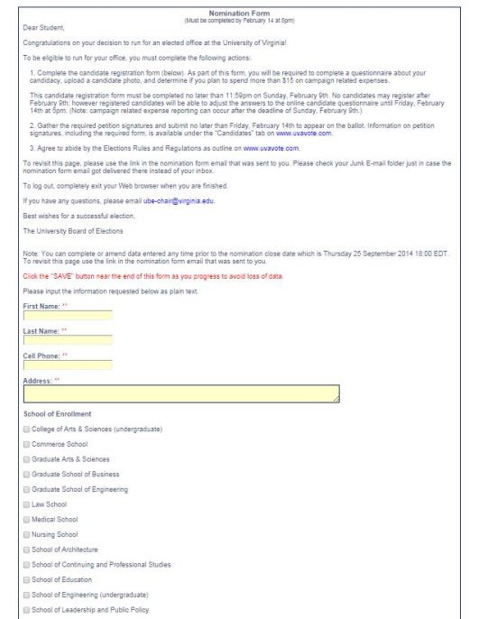

Slide 5
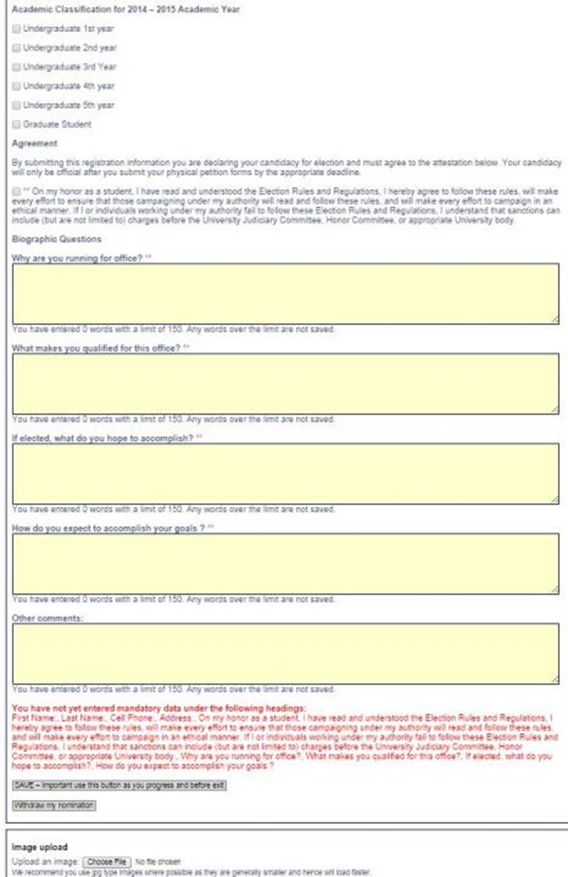

Slide 6
Candidate Petitions
Some positions require a candidate to obtain petition signatures to certify their candidacy.
Petition signatures are only required for the following positions:
Student Council President, VPA, and VPO
Third Year President and Vice President
Fourth Year Trustees President and Vice President
Second Year President and Vice President
Architecture School Council President
College Council President
Commerce Council President
Education Council President
Engineering Student Council President
Batten Graduate Council President
Batten Undergraduate Council President
Nursing Student Council President

Slide 7
Candidate Petitions
The number of signatures needed varies depending on the position that is being contested
UBE highly suggests that you obtain more signatures than required as many times there are signatures that are illegible and cannot be counted
The petition signature form along with the list of positions requiring petition signatures can be found on www.uvavote.com under the “Candidates” tab.
300 for Student Council President, Vice President for Administration, and Vice President for Organizations.
150 for College of Arts and Sciences
50 for Class Councils and Trustees and School of Engineering
25 for Curry School of Education, School of Architecture, School of Nursing, McIntire School of Commerce
10 for Batten School of Leadership and Public Policy

Slide 8
Candidate Petitions
If your position requires petition signatures,
turn them in at the front desk of the Programs & Councils Office (Newcomb Hall, Room 164- the PAC) during business hours (9am-5pm M-F)
Deadline to submit candidate petition with signatures to appear on the ballot: Tuesday, February 18th, 12PM
You do not need to have petition signatures in to get endorsements.

Slide 9
FYI:
ASK QUESTIONS!!!!!
Some positions require meeting with an advisor (eg. Class Council)
Check the position description for any rules specific to the position for which you are running.
Note: You do not need to currently be on the Honor Committee or UJC to run to be a representative.

Slide 10
Class Council
All candidates for Class President or VP are required to meet with their respective advisor before beginning their campaign.
Class of 2022 & 2023 candidates: contact Julia Bartus-Dobson (juliabd@virginia.edu) to set up a meeting
Class of 2021: contact Mary Elizabeth Luzar (mew8f@virginia.edu)

Slide 11
Expenditure Reporting.
All candidates regardless of expenditure amount are required to submit an Interim Campaign Expenditure Report and a Final Expenditure Report
Interim Campaign Expenditures are due Thursday, February 20th at 12 PM
Final Campaign Expenditures are due Monday, March 2nd at 4 PM
Interim Expenditure Reports must include current to date and projected expenditures – interim campaign expenditure are required to appear on the ballot (Section III.B.2.(a).4.b)
There is no spending limit. The goal of the expense reporting is promote transparent elections
Failure to properly report expenditures will be deemed a rule violation
Notes:
Expenditure reporting will be done through Google Forms.
- You submit one whether you spend anything or not

Slide 12
Rules and Regulations
Read and understand the rules completely before registering
Rules can be found on our website at www.UVAvote.com
When you register online, you must, on your Honor, attest that you understand the rules and agree to abide by them

Slide 13
Rules and Regulations
Section II: Campaigning
Section III: Elections Procedures
Section IV: Violations and Enforcement
Overview of common violations
Explanation of resolution process

Slide 14
Rules and Regulations
Alignment with University Policies
“Individuals and organizations are subject to the University’s exterior posting and chalking policy and are encouraged to consult that policy prior to posting campaign messages or materials. See: http://uvapolicy.virginia.edu/policy/PRM-008”
Key parts of the University Policy to keep in mind are:
Flyers are limited in size to 8.5 x 11 per the University Exterior Posting and Chalking Policy. See the Campaign Materials section of the Rules & Regulations for more information.
Chalking: Chalk messages must be limited to concrete, horizontal surfaces that are open to the sky, permitting messages to be washed away naturally. Chalk on brick, slate, or other non-concrete surfaces is impermissible. At no time may chalk messages be made on any building. The use of spray chalk or line chalk is strictly prohibited on any surface at any time
Include disclaimer on ALL materials (“Paid for by “)
Notes:
Section II: Campaigning and Electioneering
Campaign Materials:
All campaign materials or messages, except for chalk messages as described in Section II.B.1(d), shall bear a visible or audible disclaimer stating who paid for the material or message. Disclaimer shall specifically state “Paid for by [full name of individual(s) or group(s) who paid for the material or message].”
“One flyer or poster, not to exceed 11” by 17” in size, is permitted on each general purpose bulletin board at the direction of each candidate. Academic department bulletin boards are not to be used for campaign messages or materials. In addition, flyers and posters are not permitted on lamp posts, columns, pavement, outside walkways, railings, or doors.”
“Chalk messages must be limited to concrete, horizontal surfaces that are open to the sky, permitting messages to be washed away naturally. Chalk on brick, slate, or other non-concrete surfaces is impermissible. At no time may chalk messages be made on any building. The use of spray chalk or line chalk is strictly prohibited on any surface at any time.”
These are merely excerpts, please see the complete Rules and Regulations here: http://bit.ly/1AKhkL
Electronic Campaigning:
“Altering screen savers, internet browsers, or other computer settings on University computers is impermissible. Similar actions on personal and private computers are impermissible without the consent of a computer owner. Using chain e-mails or messages, spam mail, broadcast e-mails, or broadcast instant messages are also prohibited. Spam mail is defined as sending mail to people with whom the candidate cannot reasonably assert a personal relationship”
Email Mailing Lists
“An email mailing list for the purposes of these Rules is defined as lists containing “virginia.edu” in the full address. These include but are not limited to “mailman.virginia.edu” lists, “toolkit.itc.virginia.edu” lists, and other official and unofficial email lists for classes and student organizations.”
On-Grounds:
“All campaigning in University housing areas must be in compliance with rules and policies set forth by Residence Life and the University Record. In addition to these policies, individuals and organizations are required to adhere to additional restrictions set by Housing Department or Residence Life staff, including but not limited to Resident Advisors (RAs)”
“All campaigning in University Buildings and Facilities must be in compliance with rules set forth by the Undergraduate and Graduate Record and the appropriate University entity charged with maintenance of that building/facility. At the request of a candidate, the University Board of Elections shall investigate the rules of a University building/facility to ensure compliance.”
All campaign materials or messages, except for chalk messages as described in Section II.B.1(d), shall bear a visible or audible disclaimer stating who paid for the material or message. Disclaimer shall specifically state “Paid for by [full name of individual(s) or group(s) who paid for the material or message].”
Report all violations to ube-rules@virginia.edu
If required, UBE will go through a dispute resolution process. More information about the dispute process can be found on UVaVote.com

Slide 15
Rules and Regulations Resolution and Enforcement
UBE will look to mediate/resolve any violation as determined by the Rules and Regulations or in violation of the University policies. Please review Section IV. of the Rules and Regulations to better understand the resolution process.
University Board of Elections determines the eligibility of the candidate to appear on the ballot.
Unresolved violations against the University policies and regulations may be reported to UJC and Honor through the University Board of Elections
Notes:
Section II: Campaigning and Electioneering
Campaign Materials:
All campaign materials or messages, except for chalk messages as described in Section II.B.1(d), shall bear a visible or audible disclaimer stating who paid for the material or message. Disclaimer shall specifically state “Paid for by [full name of individual(s) or group(s) who paid for the material or message].”
“One flyer or poster, not to exceed 11” by 17” in size, is permitted on each general purpose bulletin board at the direction of each candidate. Academic department bulletin boards are not to be used for campaign messages or materials. In addition, flyers and posters are not permitted on lamp posts, columns, pavement, outside walkways, railings, or doors.”
“Chalk messages must be limited to concrete, horizontal surfaces that are open to the sky, permitting messages to be washed away naturally. Chalk on brick, slate, or other non-concrete surfaces is impermissible. At no time may chalk messages be made on any building. The use of spray chalk or line chalk is strictly prohibited on any surface at any time.”
These are merely excerpts, please see the complete Rules and Regulations here: http://bit.ly/1AKhkL
Electronic Campaigning:
“Altering screen savers, internet browsers, or other computer settings on University computers is impermissible. Similar actions on personal and private computers are impermissible without the consent of a computer owner. Using chain e-mails or messages, spam mail, broadcast e-mails, or broadcast instant messages are also prohibited. Spam mail is defined as sending mail to people with whom the candidate cannot reasonably assert a personal relationship”
Email Mailing Lists
“An email mailing list for the purposes of these Rules is defined as lists containing “virginia.edu” in the full address. These include but are not limited to “mailman.virginia.edu” lists, “toolkit.itc.virginia.edu” lists, and other official and unofficial email lists for classes and student organizations.”
On-Grounds:
“All campaigning in University housing areas must be in compliance with rules and policies set forth by Residence Life and the University Record. In addition to these policies, individuals and organizations are required to adhere to additional restrictions set by Housing Department or Residence Life staff, including but not limited to Resident Advisors (RAs)”
“All campaigning in University Buildings and Facilities must be in compliance with rules set forth by the Undergraduate and Graduate Record and the appropriate University entity charged with maintenance of that building/facility. At the request of a candidate, the University Board of Elections shall investigate the rules of a University building/facility to ensure compliance.”
All campaign materials or messages, except for chalk messages as described in Section II.B.1(d), shall bear a visible or audible disclaimer stating who paid for the material or message. Disclaimer shall specifically state “Paid for by [full name of individual(s) or group(s) who paid for the material or message].”
Report all violations to ube-rules@virginia.edu
If required, UBE will go through a dispute resolution process. More information about the dispute process can be found on UVaVote.com

Slide 16
Reporting Violations:
ASK QUESTIONS!!!!!
You are responsible for:
Yourself
Those who campaign on your behalf
Email: UBE-Rules@virginia.edu

Slide 17
Endorsements
Candidates will be given a link to sign up for interviews with endorsing organizations
Endorsement timeline:
Monday, February 10th 4PM– Tuesday, February 11th 4PM: Sign up to interview
Thursday, February 13th – Monday, February 17th : Interviews

Slide 18
Campaigning
Friday, February 21st at 10 AM
-
Friday, February 28th at 4 PM
(when the voting period ends)

Slide 19
Voting
Wednesday, February 26th at 10 AM
-
Friday, February 28th at 4 PM

Slide 20
Campaign Grants
Tier 1 ($150): Student Council President
Tier 2 ($100): Student Council VPO; Student Council VPA; College of Arts & Sciences representatives: Honor Committee, Judiciary Committee, Student Council
Tier 3 ($75): Arts & Sciences Council positions; Class Councils & Trustees: 2nd Year President & Vice President, 3rd Year President & Vice President, 4th Year Trustee President & VP; School of Engineering representatives: Honor Committee, Judiciary Committee, Student Council
Tier 4 ($50): Honor Committee non-CLAS/SEAS reps; Judiciary Committee non-CLAS/SEAS reps; Student Council non-CLAS/SEAS reps; Architecture Council positions; Commerce Council positions; Education School Council positions; Engineering Student Council positions; Nursing Council positions
Deadline to apply: Friday, February 7th at 11:59pm

Slide 21
Instant Runoff Voting or “Ranking”
This is for single-winner races. You may cast sequential votes. You will check each box in order of preference. Your preferred candidate should be numbered one (1); your second most preferred candidate should be numbered two (2), etc. Candidates you do not wish to endorse, leave blank.
If any candidate has a majority of the votes, they win automatically.
Otherwise, the lowest-performing candidate gets eliminated and their votes are re-allocated to their next preference. This process repeats until a single candidate has a majority of the vote

Slide 22
First Past the Post or “Select Candidates”
This is for multiple-winner races. You are not ranking candidates in this case; you are selecting one candidate for each open seat.
The number of open seats will vary depending on the position, which is indicated just below the name of the position on the ballot.

Slide 23
Candidate Resources
on UVAvote.com
Elections Calendar
Rules and Regulations
Candidate Info Packet
Info Session PowerPoint
Positions & Descriptions
Petition Form
Expenditure Reports
Campaign Grant Application

Slide 24
Questions?
Just ask!
For more information, visit our website at www.UVAvote.com
Or email ube-admin@Virginia.edu
Thanks for coming!

